Slide 1


Stock Market Analysis
Aniket Kashyap 21052050
Chetan Dev Maskara 21052151
Harshil Gautam 21052155

Slide 2

Introduction
Stock market analysis involves evaluating the performance of individual stocks, entire sectors, or even entire markets to make informed investment decisions. It encompasses various techniques and methodologies to assess the past performance, current status, and potential future trends of stocks or markets. Python is a powerful programming language commonly used for stock market analysis due to its extensive libraries for data manipulation, statistical analysis, and visualization.

Slide 3
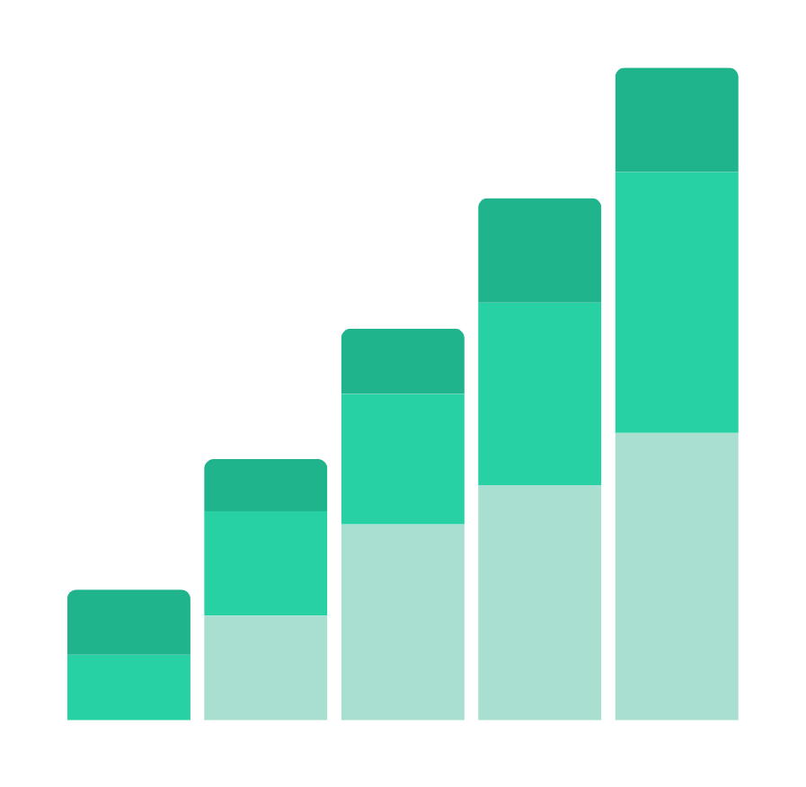
Data Analysis
Data Collection: Python can be used to collect stock market data from various sources such as financial websites, APIs (Application Programming Interfaces), and databases. Libraries like Pandas, BeautifulSoup, and requests are commonly used for web scraping and data retrieval.
Data Cleaning and Preprocessing: Once the data is collected, Python can be used to clean and preprocess it by removing missing values, handling outliers, and formatting the data into a suitable format for analysis. Pandas is particularly useful for data manipulation and preprocessing tasks.

Slide 4


Pyhton libraries used
Python provides a wide range of libraries and tools for performing both fundamental and technical analysis. For fundamental analysis, libraries like Pandas, NumPy, and Statsmodels can be used to calculate financial ratios, perform regression analysis, and conduct valuation modeling. For technical analysis, libraries like TA-Lib and Matplotlib can be used to plot charts, calculate technical indicators, and identify trading signals. Python offers powerful visualization libraries such as Matplotlib, Seaborn, and Plotly, which can be used to create interactive charts, graphs, and dashboards to visualize stock market data and analysis results.

Slide 5
OBJECTIVES
01.
02.
03.
Gathering and processing vast amounts of stock market data from various reliable sources.
Performing comprehensive analysis, including but not limited to: trend analysis, volatility assessment, correlation studies, and fundamental analysis.
Implementing advanced statistical and machine learning techniques to forecast stock prices and identify potential market movements.

Slide 6
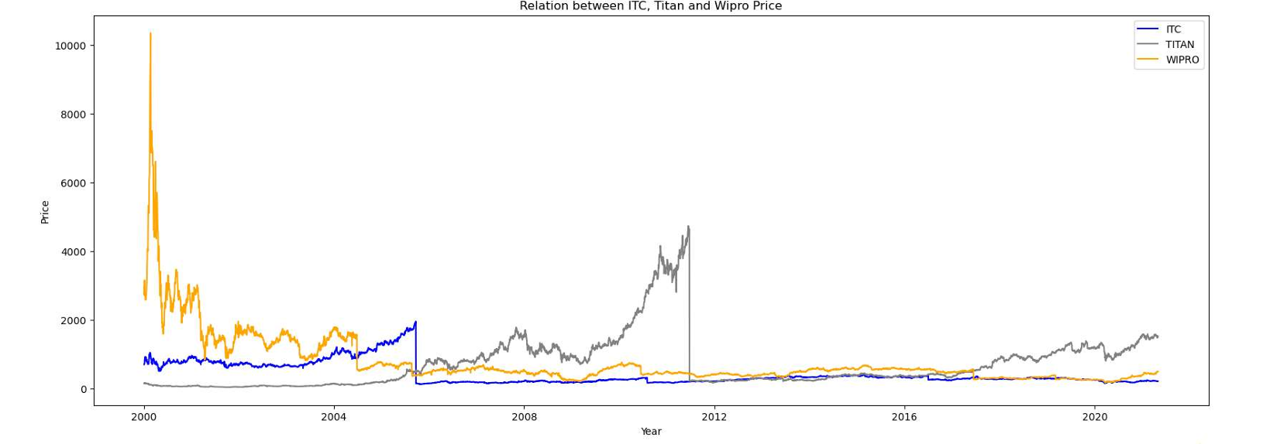
Data Presentattion
Relation between ITC,Wipro and Titan prices

Slide 7
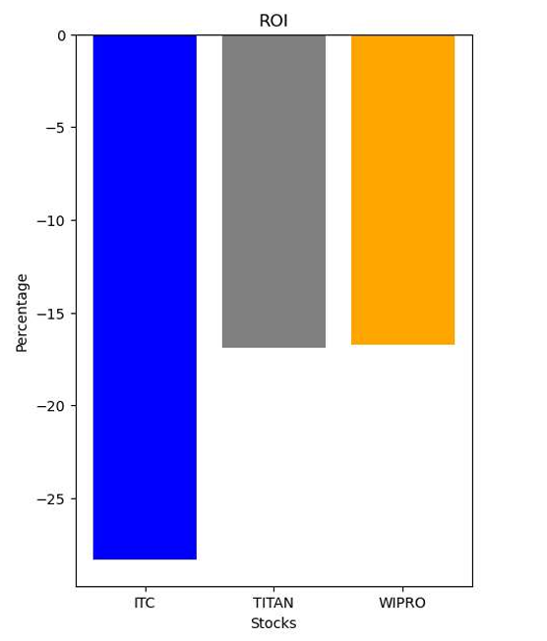
Return on Investment

Slide 8
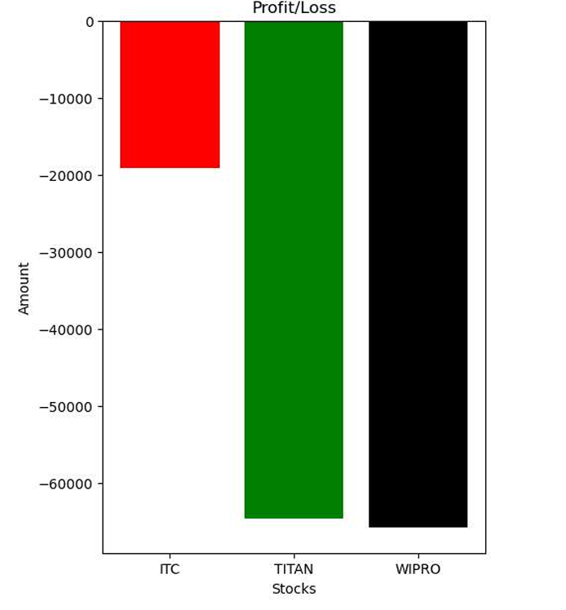
Profit/Loss Summary

Slide 9

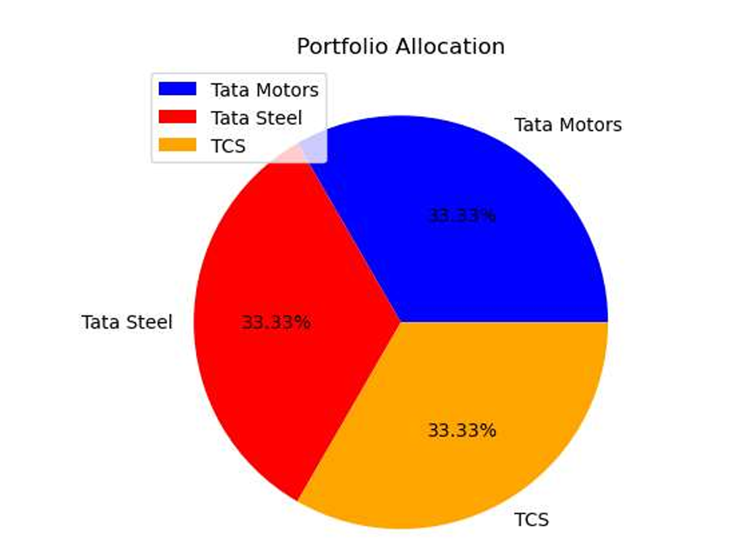
Portfolio Analysis

Slide 10
Conclusion
The project involved analyzing the stock market data for three companies: ITC, TITAN, and WIPRO. Various tasks were performed, including data loading, data exploration, data manipulation, visualization, and financial analysis. Data Loading and Exploration: The stock market data for each company was loaded into pandas DataFrames from CSV files. Basic exploratory data analysis was conducted to understand the structure and contents of the datasets. This included checking the size, data types, presence of null values, and descriptive statistics of the data. Data Manipulation: Necessary data manipulations were performed, such as converting the date column to datetime format and adding new columns for year, month, and day to facilitate further analysis. Financial calculations were carried out to determine the total investment, number of shares owned, and ROI (Return on Investment) for each company. Visualization: Data visualization techniques, including line plots and bar graphs, were used to visualize the stock prices, trading volumes, ROI, and profit/loss amounts. The visualizations provided insights into the trends, patterns, and performance of the companies over time.

Slide 11

Thank you very much!

